Slide 1
(Site Name, e.g., LARC Harare)
[Identify which Viral Load Cascade component the project addresses (e.g., Result Reporting/Patient Management)]
Speaker Name, Title,
Organization
Date

Slide 2
Team
List the members of the team
Include photo of LARC team

Slide 3
Facility Name Information / Background
Photo here if possible
Brief description of the facility
Level of the facility
# of patients on ART
# patients VL eligible
# VL samples collected / month
VL Coverage
VL Suppression Rate

Slide 4
The Story of Our Project
Connect every tool to your project

Slide 5
Project Summary
What are we trying to accomplish? | How will we know if a change is an improvement? | What change will we make that will result in an improvement?
Overarching Goal | AIM Statement Improve (increase, decrease) _______ (metric) from _____ to ____ by ________ (date). | Intervention (Describe the key elements of your new process/intervention DO NOT complete until LS #2

Slide 6
Elevator Speech
This project is about _________________________________________
As a result of these efforts, (What will your project actually accomplish)
It’s important because we are concerned about:
___(Big Picture Here)_________________
____________________
Success will be measured by showing improvement in: (Metrics here)
____________________
____________________
What we need from you –
___(Describe to whom you are presenting the “ask”) What do you need from this person? Or organization?___________________________

Slide 7
DEFINE
Process Map: The First Step Towards Improvement
(Show your process map. Use any format that you have learned - chart, swim lanes, photo of sticky notes on paper. Highlight the area/s for improvement)

Slide 8
Process Table: The First Step Towards Improvement
DEFINE
Process Step | What Happens? | Who is responsible? | Duration | Forms/logs | Opportunity for Improvement
(Show your process table. Provide sufficient detail of the entire process. Highlight the area/s for improvement.)

Slide 9
DEFINE
Gap (Problem Statement):
Write problem statement

Slide 10
DEFINE
Voice of Customer (VOC)
Who is your customer? (patients, health care workers) Did you select the right customer for your identified problem?
Tool used to collect the VOC (survey, focus group, etc.)
Collection Process (# surveyed, method surveyed)
Results (Display)
What did you learn? How did you apply what you learned in your intervention?

Slide 11
MEASURE
Metric Selected
Define Numerator / Denominator
Baseline Data
Give Percentage and Number

Slide 12
MEASURE
Data Collection Process
Data Collection Tool
List or insert picture (if available) of any data collection tool that was used for your project
Data Collection Plan
How many data points for baseline?
Timeframe of data collection. How frequently did you collect your data? – baseline & project data?
Populate a raw Data Table
Data Analysis
How did you interpret your data?
What did you learn about the magnitude of the problem?

Slide 13
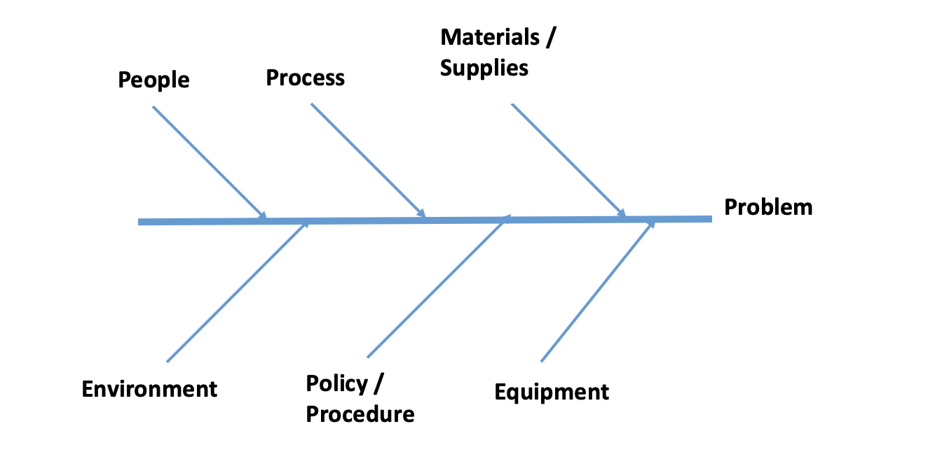
ANALYZE
Root Cause - insert picture/diagram of your fishbone diagram or other tool used. Circle your root cause.

Slide 14
IMPROVE
IMPACT / EFFORT GRID A Tool for Prioritizing Opportunities
Projects - Detailed planning and work
Major
Improvement
Just Do It
IMPACT
Just Do It if Impactful
Maybe some day
Minor
Improvement
Easy to Do
Difficult to Do
EFFORT

Slide 15
IMPROVE
Just Do It (JDI)
List or show photos of all the JDIs completed

Slide 16
IMPROVE
5S - BEFORE
5S - AFTER
Insert Photo
Insert Photo
Notes:
16
16

Slide 17
IMPROVE
5S - BEFORE
5S - AFTER
Insert Audit Score
Insert Audit Score
Notes:
17
17

Slide 18
IMPROVE
Visual Management
Photos of Visual Management Changes
Notes:
18
18

Slide 19
IMPROVE
Small Test of Change (PDSA #1) – Change Tested, Dates Tested
ACT
PLAN
DO
STUDY
PDSA – Describe in Detail your PDSA. Did you Adopt, Adapt or Abandon?
Notes:
19
19

Slide 20
IMPROVE
Small Test of Change (PDSA #2) - Change Tested, Dates Tested
ACT
PLAN
DO
STUDY
PDSA – Describe in Detail your PDSA. Did you Adopt, Adapt or Abandon?
Notes:
20
20

Slide 21
IMPROVE
Small Test of Change (PDSA #3) - Change Tested, Dates Tested
ACT
PLAN
DO
STUDY
PDSA – Describe in Detail your PDSA. Did you Adopt, Adapt or Abandon?
Notes:
21
21

Slide 22
IMPROVE
Intervention – Standard Work
What did you do to solve your problem?
Give an overview of your intervention
Show your Standard Work
Notes:
22
22

Slide 23
IMPROVE
‘Before’ State Process Map
‘After’ State Process Map
Show New Process [May use boxes, draw, or use sticky notes (must be able to read)]. Compare the problem area in the ’Before’ State process map to the updated ‘After’ State process map.
Notes:
23
23

Slide 24
IMPROVE
Data Display
Show your run chart
Annotate your run chart, showing the different PDSAs / Tests of Change
Notes:
24
24

Slide 25
CONTROL
Show your Control Plan

Slide 26
CONTROL
Indicate to whom or what group that you have shared your presentation
Indicate any scale-up that has been done

Slide 27
Challenges
Share challenges; What did the team do to address the challenges?
Challenges
Address challenges

Slide 28
Lessons Learned
What did the team learn? Reflect on what you will do differently in the future.

Slide 29
Way Forward…

Slide 30
Appendices

Slide 31
A. Stakeholder Analysis
Display which one of the two tools used

Slide 32
B. Team Formation
Identify team members and their roles

Slide 33
C. Process Table: The First Step Towards Improvement
DEFINE
Process Step | What Happens? | Who is responsible? | Duration | Forms/logs | Opportunity for Improvement
(Show your process table. Provide sufficient detail of the entire process. Highlight the area/s for improvement.)

Slide 34
D. Action Plan
TOPIC/GOALS | ACTION ITEM | BY WHOM? | BY WHEN?
Action Plan – Create / update the action plan following each learning session

Slide 35
E. Capability Maturity Model (CMM)
Viral Load Cascade | Before LARC | After LARC
Demand Creation
Specimen Collection & Processing
Lab Testing
Result Reporting
Result Interpretation and Client Management

Slide 36
Project Deliverables
On-Site / Session 1
DEFINE / MEASURE / ANALYZE
Session 2
IMPROVE
Session 3
CONTROL
Identify Stakeholders
Team Formation
Map the Process (Current)
ID / Prioritize Opportunities
Project Outline
Baseline Metrics - Data Collection Tool/Plan
Action Plan
Elevator Speech
VOC Information
Root Cause Analysis
1 Rapid/Small Test of Change (PDSA)
Presentation
Update Project Outline, if necessary
1 5S Exercise
1 Visual Management Application
2 or more Tests of Change (PDSA)
Select and Implement Change
Modify Solution(s) where necessary by additional Test of Change (PDSA)
Create Future State Map
Standard Work
Presentation
Update Project Outline, if necessary
Validate Solution(s) / Interventions
Create Control Plan
Transfer to Operational Owner
Share/Spread Intervention, if applicable
Final Presentation
Project Champion
Notes:
Just in Time training to accomplish deliverables

